Slide 1


Data science capstone project
K.Adithya
10/08/2024

Slide 2

Outline
Executive Summary
Introduction
Methodology
Results
Conclusion
Discussion

Slide 3
Executive Summary
The intention behind this capstone project was to predict if a SpaceX Falcon 9 first stage will land successfully or not using different machine learning classification algorithms.
The general view of this project goes like this :
Data collection, wrangling, and formatting
Exploratory data analysis
Interactive data visualization
Machine learning prediction
According to our plots, a couple of features of the rocket launches are slightly correlated with the launch outcome, that is, as success or failure.
It therefore leads to the conclusion that a decision tree model might be the most appropriate of the machine learning algorithms that can predict whether the Falcon 9 performs a successful first stage.

Slide 4
Introduction
In this capstone, we will make a prediction of whether the Falcon 9 first stage will land successfully. SpaceX, on its webpage, advertises Falcon 9 rocket launches for 62 million dollars; other providers cost upward of 165 million dollars each, much of the savings because SpaceX can reuse the first stage. Therefore, if we can determine whether or not the first stage can land, then we can estimate the cost for launching. That information comes in handy when some other alternate company might want to bid against SpaceX on a rocket launch.
Most landings that fail are planned. Sometimes SpaceX will do a controlled landing in the ocean.
The guiding question is this: Given a set of features regarding a Falcon 9 rocket launch, which includes payload mass, orbit type, launch site, and so on, the first stage of the rocket will land successfully.

Slide 5

Section 1

Slide 6
Methodology
•The overall methodology includes:
1.Data collection, wrangling, and formatting, using:
SpaceX API
Web scraping
2.Exploratory data analysis (EDA), using:
Pandas and NumPy
SQL
3.Data visualization, using:
Matplotlib and Seaborn
Folium
Dash
4.Machine learning prediction, using
Logistic regression
Support vector machine (SVM)
Decision tree
K-nearest neighbors (KNN)

Slide 7
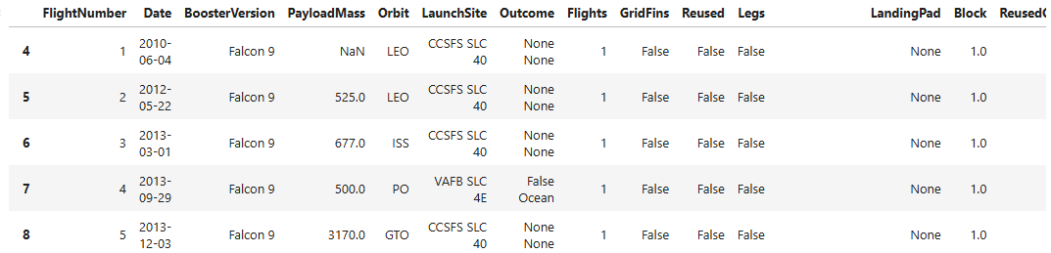
Data Collection
SpaceX API
The API used is https://api.spacexdata.com/v4/rockets/.
The API provides data about many types of rocket launches done by SpaceX, the data is therefore filtered to include only Falcon 9 launches.
Every missing value in the data is replaced the mean the column that the missing value belongs to.
We end up with 90 rows or instances and 17 columns or features. The picture below shows the first few rows of the data:

Slide 8
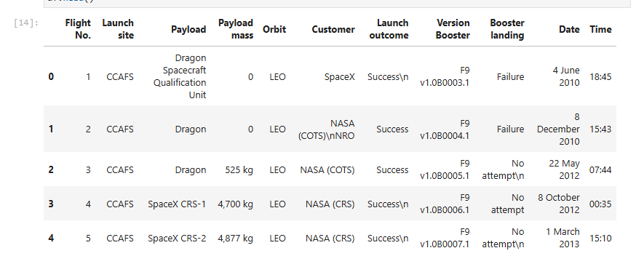
Data Collection - Scraping
Web scraping
• The data is scraped from https://en.wikipedia.org/w/index.php?title=List_of_Falcon_9_and_Falcon_Heavy_launches&oldid=1027686922
• The website contains only the data about Falcon 9 launches.
• We end up with 121 rows or instances and 11 columns or features. The picture below shows the first few rows of the data:

Slide 9
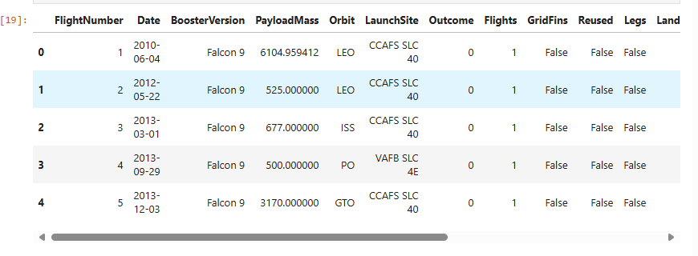
Data Wrangling
The data is later processed so that there are no missing entries and categorical features are encoded using one-hot encoding.
An extra column called ‘Class’ is also added to the data frame. The column ‘Class’ contains 0 if a given launch is failed and 1 if it is successful.
In the end, we end up with 90 rows or instances and 83 columns or features.

Slide 10
EDA with Data Visualization
Pandas and NumPy
Functions from the Pandas and NumPy libraries are used to derive basic information about the data collected, which includes:
The number of launches on each launch site
The number of occurrence of each orbit
The number and occurrence of each mission outcome
SQL
The data is queried using SQL to answer several questions about the data such as:
The names of the unique launch sites in the space mission
The total payload mass carried by boosters launched by NASA (CRS)
The average payload mass carried by booster version F9 v1.1

Slide 11
Build an Interactive Map with Folium and Seaborn
Matplotlib and Seaborn
Functions from the Matplotlib and Seaborn libraries are used to visualize the data through scatterplots, bar charts, and line charts.
The plots and charts are used to understand more about the relationships between several features, such as:
The relationship between flight number and launch site
The relationship between payload mass and launch site
The relationship between success rate and orbit type
Folium
Functions from the Folium libraries are used to visualize the data through interactive maps.
The Folium library is used to:
Mark all launch sites on a map
Mark the succeeded launches and failed launches for each site on the map
Mark the distances between a launch site to its proximities such as the nearest city, railway, or highway

Slide 12
Build a Dashboard with Plotly Dash
Dash
Functions from Dash are used to generate an interactive site where we can toggle the input using a dropdown menu and a range slider.
Using a pie chart and a scatterplot, the interactive site shows:
The total success launches from each launch site
The correlation between payload mass and mission outcome (success or failure) for each launch site

Slide 13
Predictive Analysis (Classification)
Functions from the Scikit-learn library are used to create our machine learning models.
The machine learning prediction phase include the following steps:
Standardizing the data
Splitting the data into training and test data
Creating machine learning models, which include:
Logistic regression
Support vector machine (SVM)
Decision tree
K nearest neighbors (KNN)
Fit the models on the training set
Find the best combination of hyperparameters for each model
Evaluate the models based on their accuracy scores and confusion matrix

Slide 14
Results
The results are split into 5 sections:
SQL (EDA with SQL)
Matplotlib and Seaborn (EDA with Visualization)
Folium
Dash
Predictive Analysis
In all of the graphs that follow, class 0 represents a failed launch outcome while class 1 represents a successful launch outcome.

Slide 15

Section 2

Slide 16
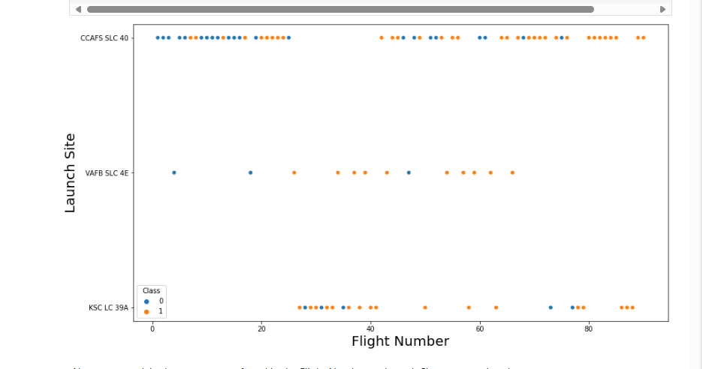
Flight Number vs. Launch Site
The below figure shows the Flight Number of rockets and the base from they are launched

Slide 17
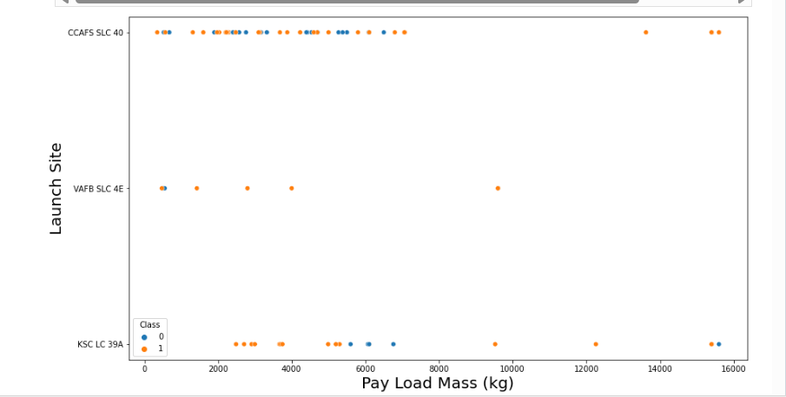
Payload vs. Launch Site
This figure shows relation between payload and Launch site. Depending on payload what site was chosen for what payload category

Slide 18
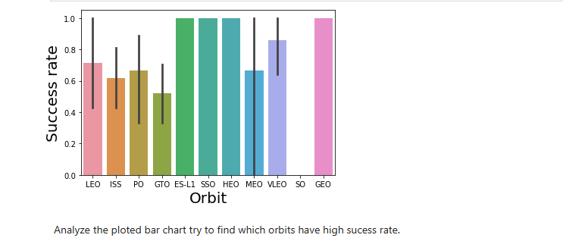
Success Rate vs. Orbit Type
This figure shows the relation between orbital type and success rate of rockets launched to those orbits

Slide 19
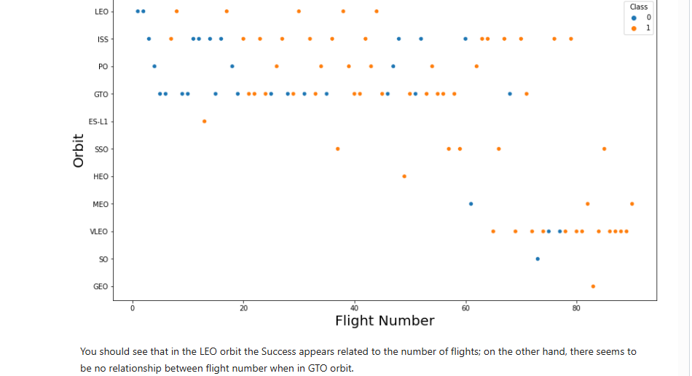
Flight Number vs. Orbit Type
This figure shows the flight numbers and their orbital types

Slide 20
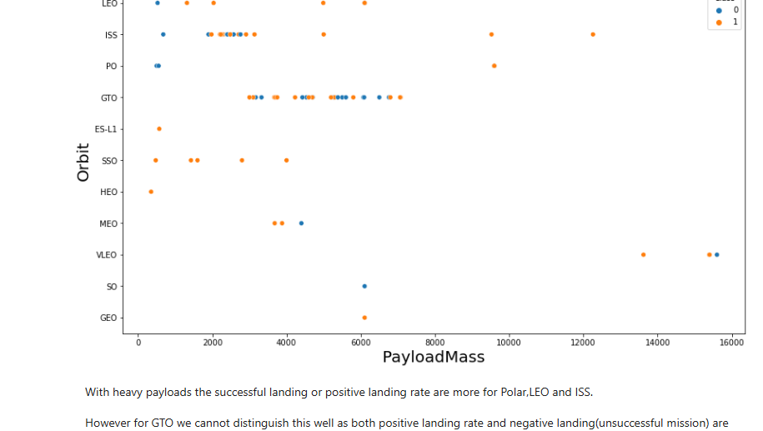
Payload vs. Orbit Type
This figure shows the type of payload is used for various orbital levels

Slide 21
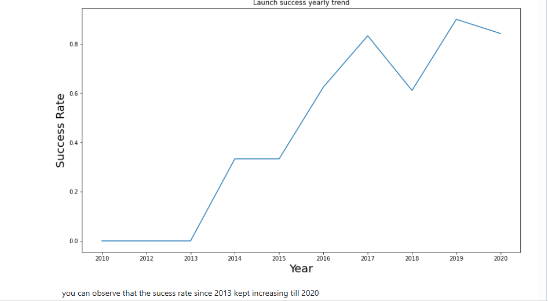
Launch Success Yearly Trend
This figure shows the successful trend of rocket launches.

Slide 22
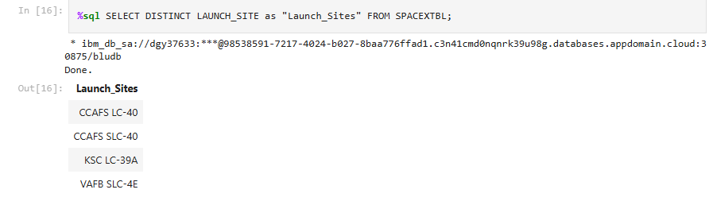
All Launch Site Names
The below figure shows all lauch site names

Slide 23
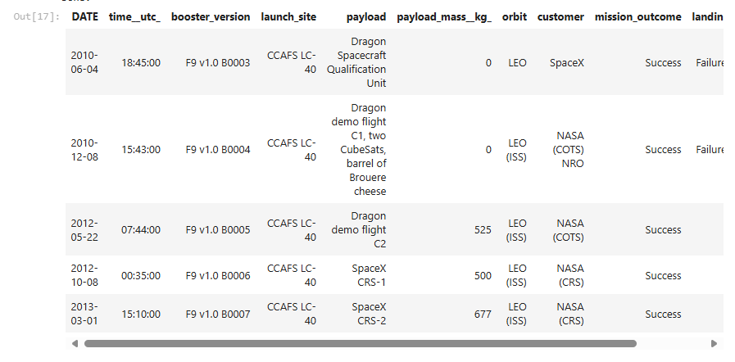
Launch Site Names Begin with 'CCA'
This figure shows 5 records where launch sites begin with `CCA`

Slide 24


Total Payload Mass and Average Payload Mass by F9 v1.1
The total payload carried by boosters from NASA
The average payload mass carried by booster version F9 v1.1

Slide 25

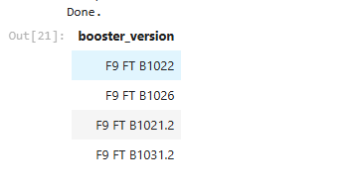
First Successful Ground Landing Date and Successful Drone Ship Landing with Payload between 4000 and 6000
The first successful landing outcome on ground pad
The names of boosters which have successfully landed on drone ship and had payload mass greater than 4000 but less than 6000

Slide 26

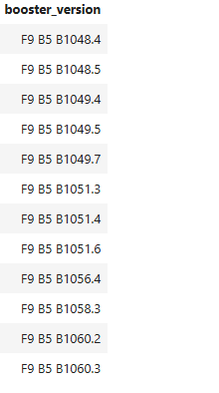
Total Number of Successful and Failure Mission Outcomes and Boosters Carried Maximum Payload
The total number of successful and failure mission outcomes
The names of the booster which have carried the maximum payload mass

Slide 27
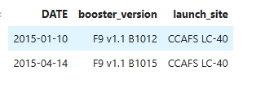
2015 Launch Records
The failed landing_outcomes in drone ship, their booster versions, and launch site names for in year 2015

Slide 28
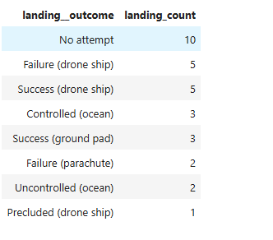
Rank Landing Outcomes Between 2010-06-04 and 2017-03-20
Ranking the count of landing outcomes (such as Failure (drone ship) or Success (ground pad)) between the date 2010-06-04 and 2017-03-20, in descending order.

Slide 29

Section 3

Slide 30
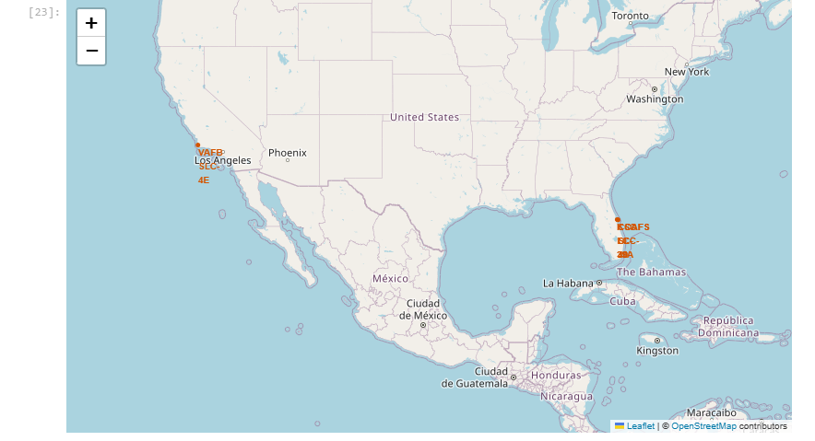
All launch sites on a map with folium
Exploring the generated folium map and all launch sites’ location markers on a global map and they are CCAFS LC-40,CCAFS SLC-40,KSC LC-39A ,VAFB SLC-4E

Slide 31
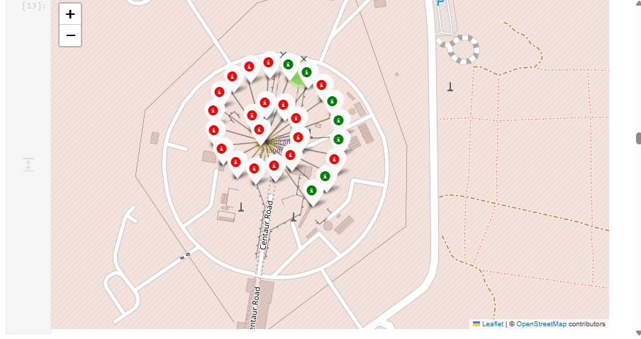
Successful launch outcomes at a site
Exploring the folium map to show the color-labeled launch outcomes on the map. Site : CCAFS LC-40 . Red tag shows it fail and green mean success

Slide 32
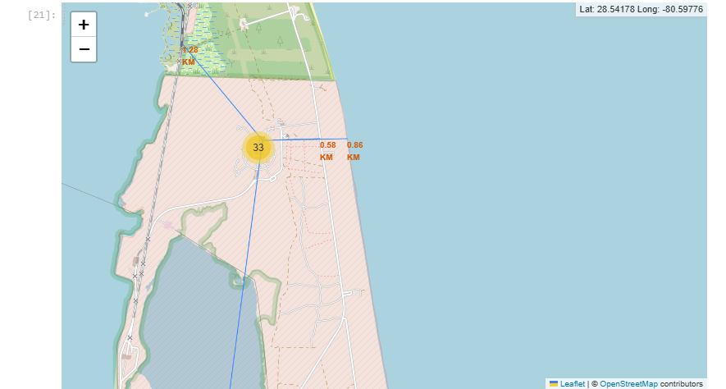
Infrastructure distance from launch site
Exploring the generated folium map of a selected launch site to its proximities such as railway, highway, coastline, with distance calculated and displayed.
distance_highway = 0.5834695366934144 km distance_railroad = 1.2845344718142522 km distance_city = 51.434169995172326 km

Slide 33

Section 4

Slide 34
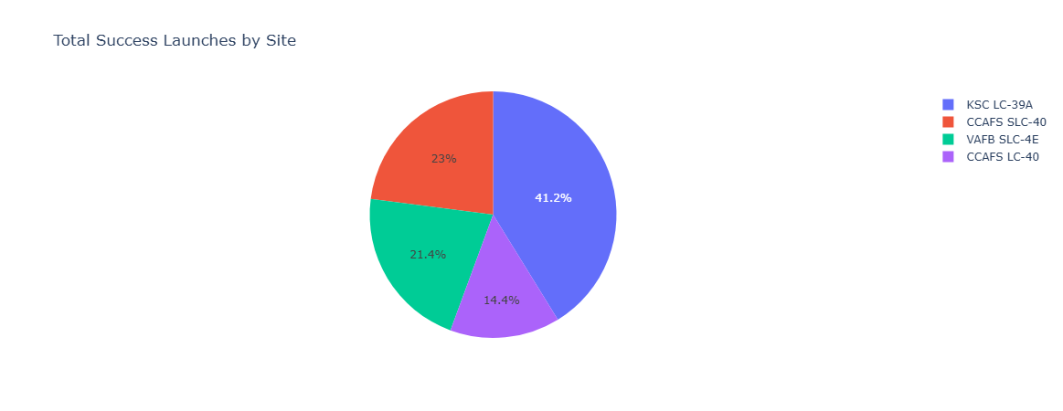
Success rate of each launch site
This below figure shows launch success count for all sites, in a pie-chart.

Slide 35
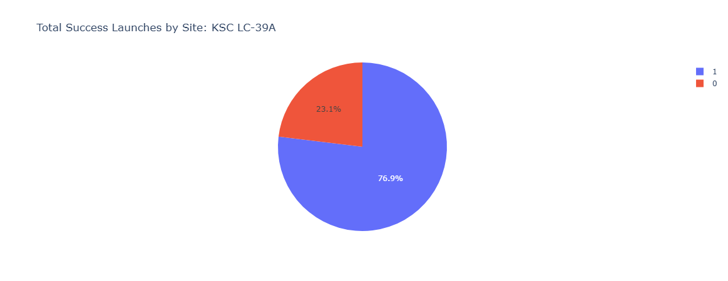
Launch site with highest success ratio
The pie-chart for the launch site with highest launch success ratio is KSC LC-39A with a success rate of 76.9%

Slide 36
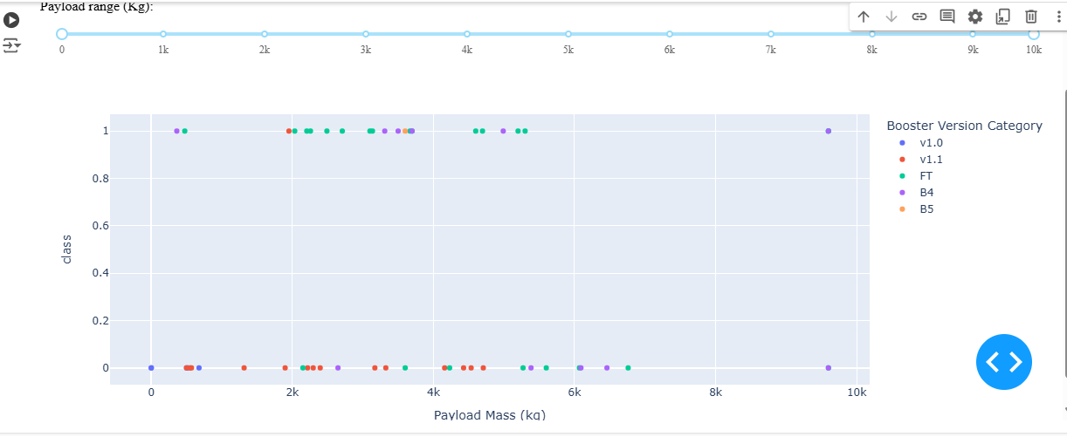
Payload vs Booster version
Payload vs. Booster version scatter plot for all sites, with different payload selected in the range slider. Class 0 shows failed and class one shows success.

Slide 37

Section 5

Slide 38
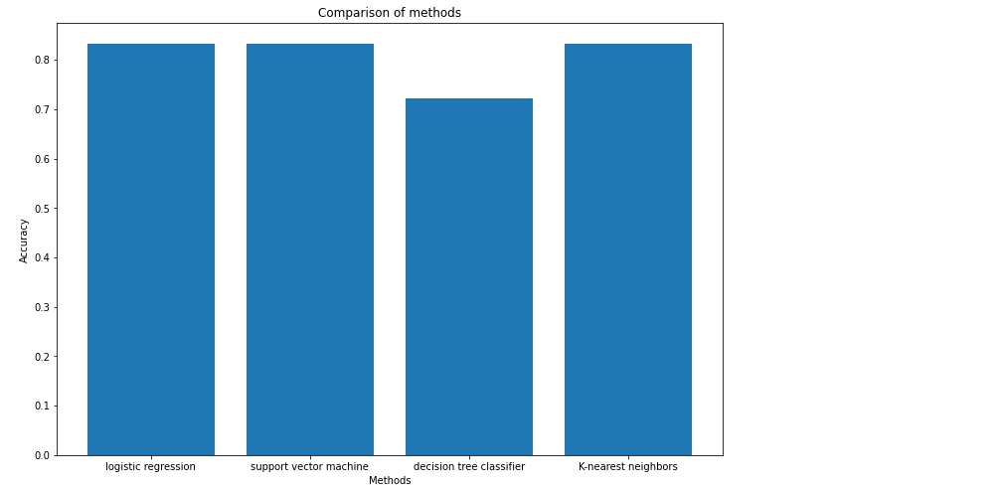
Classification Accuracy
This below chart Visualizes the built model accuracy for all built classification models, in a bar chart.
Logistic regression, Support vector machine and K-nearest neighbors, all of these three methods give the best performance, with accuracy of 0.8333333333333334.

Slide 39
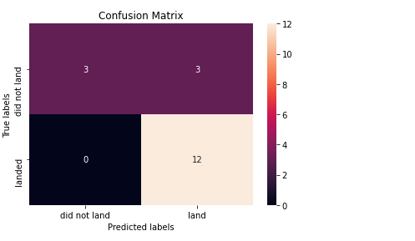
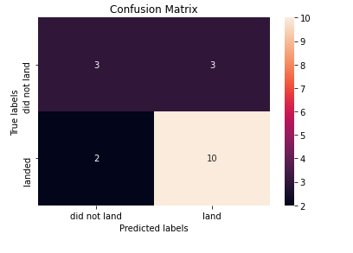
Confusion Matrix
Putting the results of all 4 models on a bar chart, we can see that except decision tree model all share the same accuracy score and confusion matrix when tested on the test set.
Fig 1 shows confusion matrix of all three that is logistic, K means, SVM and fig 2 shows confusion matrix of decision tree

Slide 40
Conclusions
Therefore, their GridSearchCV best scores on a training data set and it is used to rank them instead. Based on the GridSearchCV best scores, the models are ranked in the following order with the first being the best and the last one being the worst:
Decision tree (GridSearchCV best score: 0.8892857142857142)
K nearest neighbors, KNN (GridSearchCV best score: 0.8482142857142858)
Support vector machine, SVM (GridSearchCV best score: 0.8482142857142856)
Logistic regression (GridSearchCV best score: 0.8464285714285713)
Based on test set only Decision Tree set performs worst it shows overfitting with accuracy of 0.72 on test data and other models perform similarly on test data with an accuracy of 0.83

Slide 41
Discussion
From the data visualization section, we can see that some features may have correlation with the mission outcome in several ways. For example, with heavy payloads the successful landing or positive landing rate are more for orbit types Polar, LEO and ISS. However, for GTO, we cannot distinguish this well as both positive landing rate and negative landing(unsuccessful mission) are both there here.
Therefore, each feature may have a certain impact on the final mission outcome. The exact ways of how each of these features impact the mission outcome are difficult to decipher. However, we can use some machine learning algorithms to learn the pattern of the past data and predict whether a mission will be successful or not based on the given features.

Slide 42


